Slide 1
Hypertension
- High blood pressure, also known as hypertension, is a common condition. It affects millions of people worldwide. It can lead to serious health problems if left untreated.

Slide 2

Causes of Hypertension
- Genetics can play a role. Lifestyle factors like diet, exercise, and stress can contribute. Certain medical conditions can also cause hypertension.

Slide 3

Symptoms of Hypertension
- Often, there are no noticeable symptoms. Headaches, dizziness, and nosebleeds can be signs. Regular blood pressure checks are essential for early detection.

Slide 4
Hyperlipidemia
- High cholesterol, also known as hyperlipidemia, is another common condition. It involves high levels of lipids (fats) in the blood. It can contribute to heart disease and stroke.

Slide 5

Causes of Hyperlipidemia
- Genetics can play a role. Diet high in saturated and trans fats can contribute. Lack of physical activity can also be a factor.

Slide 6
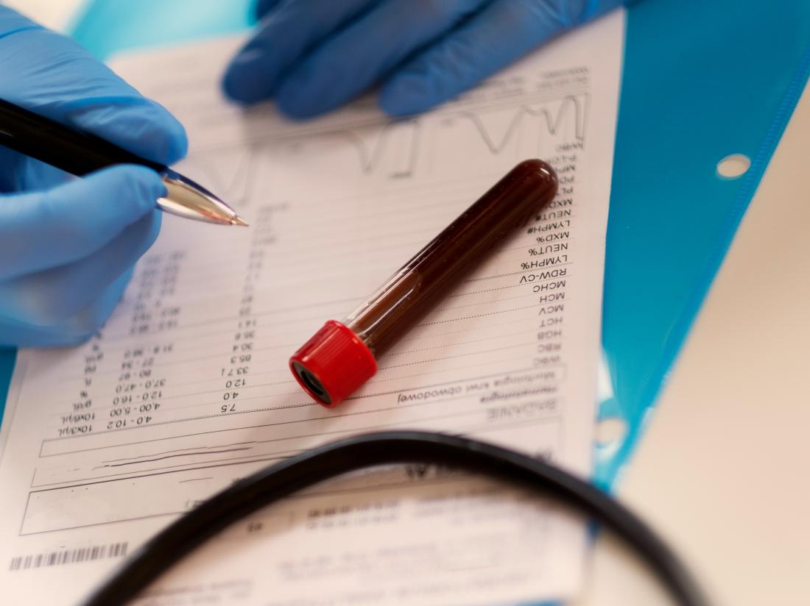
Symptoms of Hyperlipidemia
- Often, there are no noticeable symptoms. Regular blood tests are essential for early detection. Early detection allows for timely intervention and management.

Slide 7
Management of Hypertension and Hyperlipidemia
- Lifestyle modifications are key: - Healthy diet - Regular exercise - Stress management Medications may be necessary in some cases. Regular monitoring and follow-up with a healthcare professional are essential.

